Slide 1
Chapter 11: Performance Monitoring
Instructor-led overview and operational guidance

Slide 2
Learning Objectives
01 Explain the key administrative ideas in Chapter 11
02 Identify the relevant Windows Server tools, workflows, and decision points
03 Relate the topic set to real operational and security practices
04 Prepare for later hands-on administration and troubleshooting work
Windows Server 2025 | Chapter 11 | Performance Monitoring
02

Slide 3
Chapter Topics
01 11.1 Counters
02 11.2 Live monitoring
03 11.3 Data collection
04 11.4 Monitoring and troubleshooting
Windows Server 2025 | Chapter 11 | Performance Monitoring
03

Slide 4
11.1 Counters
Performance counters measure resource and workload activity so administrators can observe system behavior over time.
Counter objects and instances
Baseline and trend value
Relation to troubleshooting and planning
Windows Server 2025 | Chapter 11 | Performance Monitoring
04

Slide 5
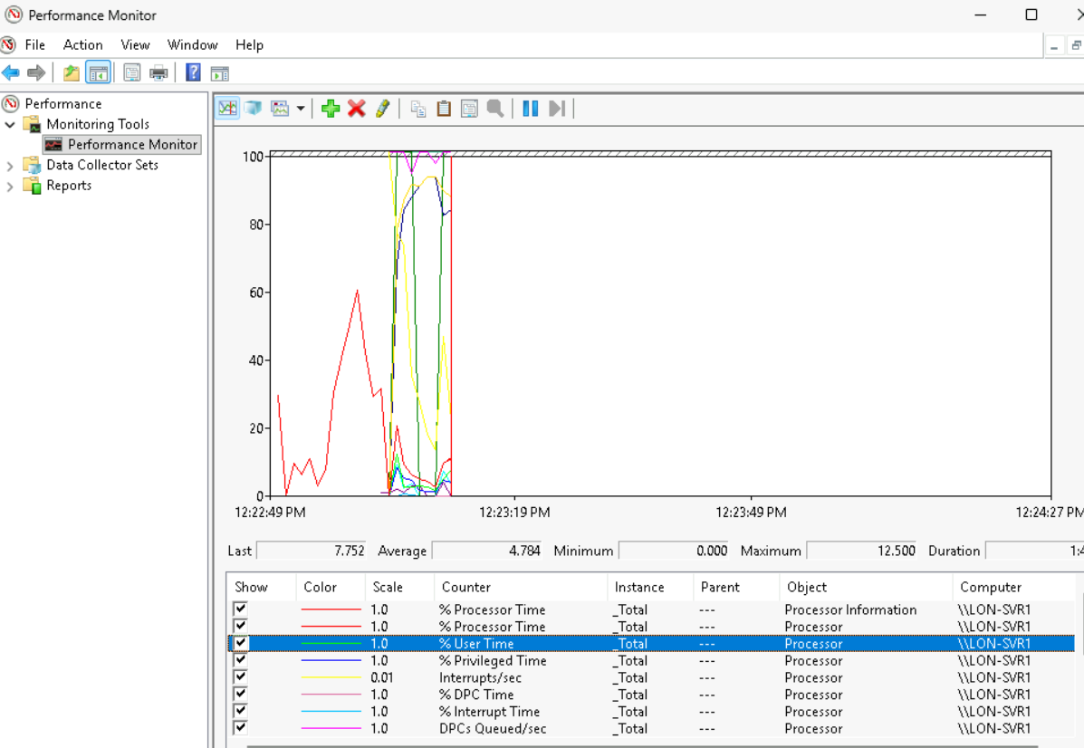
Performance Monitor

Slide 6
11.2 Live Monitoring
Live monitoring means observing server performance in real time to understand current activity and spot active issues.
Real-time views
Immediate operational feedback
Interactive observation tools
Windows Server 2025 | Chapter 11 | Performance Monitoring
05

Slide 7
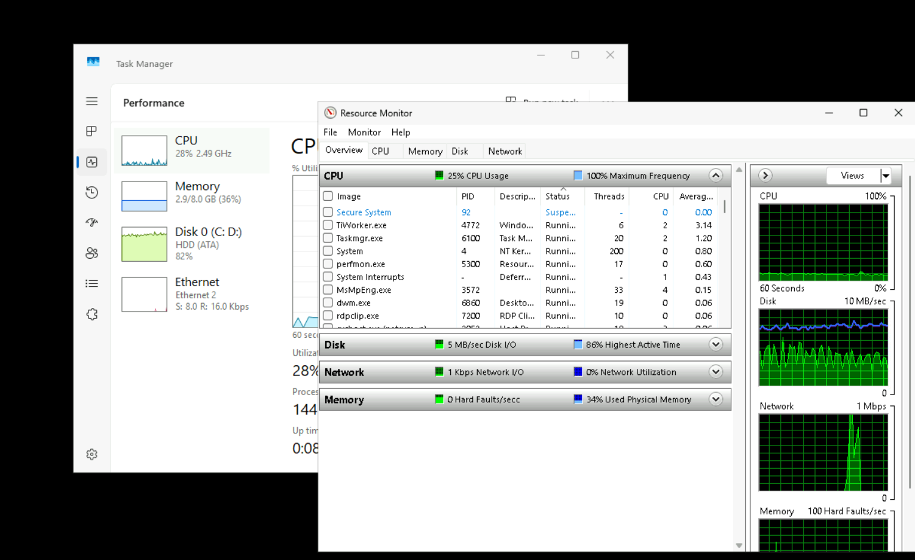
Task Manger and Resource Monitor

Slide 8
11.3 Data Collection
Data collection captures performance data over time so administrators can analyze trends, baselines, and intermittent issues.
Scheduled collection
Logged data and trend analysis
Repeatable operational measurement
Windows Server 2025 | Chapter 11 | Performance Monitoring
06

Slide 9

Sysinternals
The Sysinternals web site was created in 1996 by Mark Russinovich to host his advanced system utilities and technical information. Whether you’re an IT Pro or a developer, you’ll find Sysinternals utilities to help you manage, troubleshoot and diagnose your Windows and Linux systems and applications.
https://learn.microsoft.com/en-us/sysinternals/

Slide 10
Sys Internals Tools list
Common Sysinternals tools:
AccessChk
AccessEnum
ADExplorer
ADInsight
AdRestore
Autologon
Autoruns
BgInfo
CacheSet
ClockRes
Coreinfo
Ctrl2Cap
DebugView
Desktops
Disk2vhd
DiskExt
DiskMon
DiskView
Disk Usage / DU
EFSDump
FindLinks
Handle
Hex2Dec
Junction
LDMDump
ListDLLs
LiveKd
LoadOrder
LogonSessions
MoveFile
NotMyFault
NTFSInfo
PendMoves
PipeList
PortMon
ProcDump
Process Explorer
Process Monitor
PsExec
PsFile
PsGetSid
PsInfo
PsKill
PsList
PsLoggedOn
PsLogList
PsPasswd
PsPing
PsService
PsShutdown
PsSuspend
RAMMap
RegDelNull
Registry Usage / RU
RegJump
RootkitRevealer
SDelete
ShareEnum
ShellRunas
Sigcheck
Streams
Strings
Sync
Sysmon
TCPView
VMMap
VolumeID
Whois
WinObj
ZoomIt
Microsoft maintains the current Sysinternals utilities list on Microsoft Learn. (learn.microsoft.com)

Slide 11
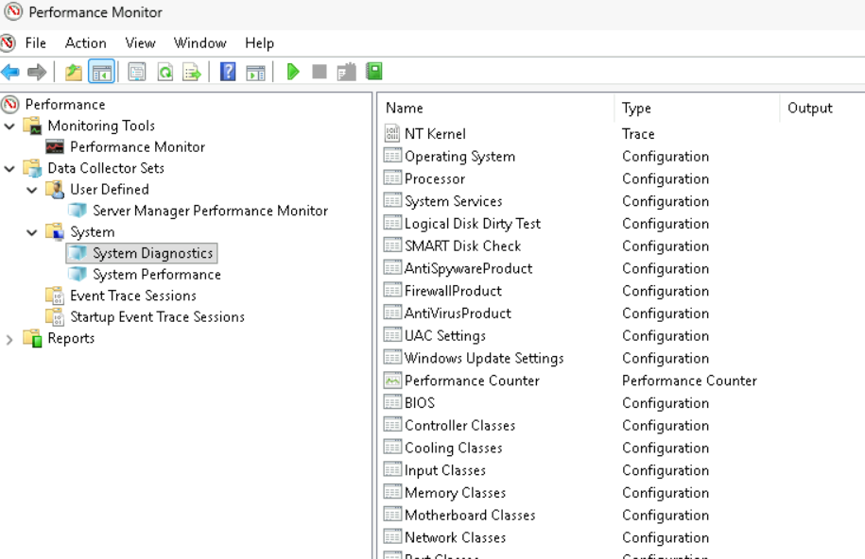
Data collector sets

Slide 12
11.4 Monitoring and Troubleshooting
Monitoring provides the evidence base for troubleshooting
Symptoms and root causes are not always the same
Validate after remediation instead of assuming the fix worked
Windows Server 2025 | Chapter 11 | Performance Monitoring
07

Slide 13
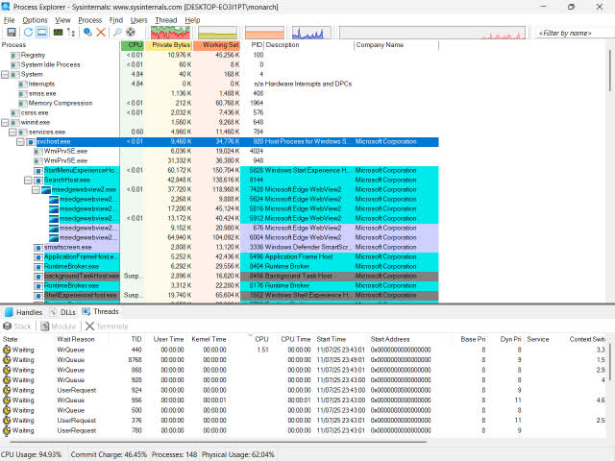
Process Explorer

Slide 14
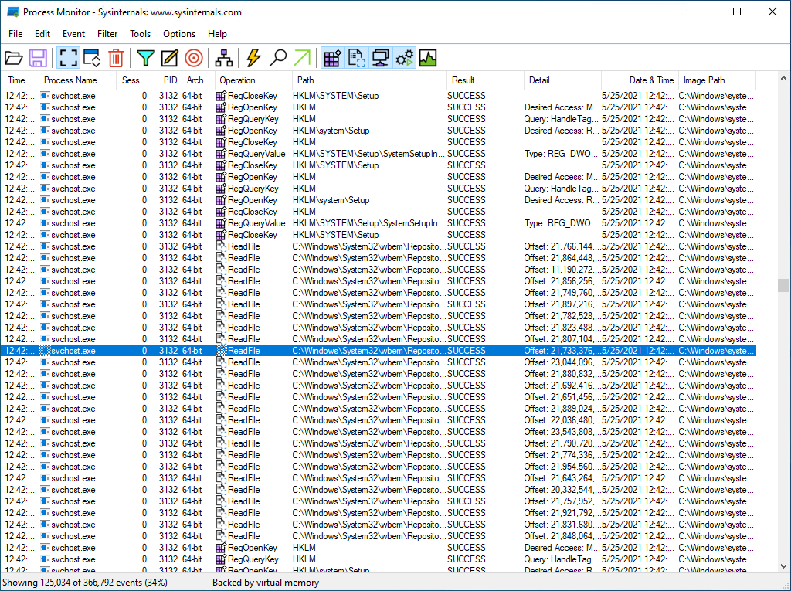
Process Monitor

Slide 15
Chapter Summary
01 Teach students to observe before changing configuration
02 Introduce counters, live views, and data collection as related but distinct activities
03 Build operational habits that support troubleshooting and capacity planning
04 Reinforce repeatable administration, validation, and supportable design choices
Windows Server 2025 | Chapter 11 | Performance Monitoring
09

Slide 16
Knowledge Check
1
What is the main administrative purpose of Counters?
2
What is the main administrative purpose of Live monitoring?
3
What is the main administrative purpose of Data collection?
4
What is the main administrative purpose of Monitoring and troubleshooting?
Windows Server 2025 | Chapter 11 | Performance Monitoring
10

Slide 17
PRACTICE LAB
Lab 1101
Monitoring Server Performance and Resource Usage
In this lab, you will use Windows Server tools to monitor system performance. You will check CPU, memory, disk, and network usage. Performance monitoring helps identify bottlenecks and ensure the server is healthy.
Windows Server 2025 | Chapter 11 | Performance Monitoring
11

